Slide 1
Bio-Mechanics Study of Human Arm based on human muscle capability and analysis & simulation of Bio-Mechanics using available software.
Presented by: Atharv Nagvekar Group: ATRC [Student Intern] Under the guidance of: Arvind Bansode Sir [Sc-E]

Slide 2
Topic:
Bio-Mechanics Study of Human Arm for deriving the characteristics of the actuator parameters based on human muscle capability and analysis & simulation of Bio-Mechanics using available software.
Schedule for 6 months [June 26 – Jan 27]
Sr. No | Task | Methodology | Result | Timeline
1 | Bio-Mechanics Study of Human Arm | Study of present research work being carried out world wide | Detailed understanding Bio-Mechanics of Human Arm | Jun-Sep 26
2 | Bio-Mechanics Study of Human Arm for deriving the characteristics of the actuator parameters based on human muscle capability | Study of present research work being | Detailed report of the study and analysis | Oct-Nov 26
3 | Analysis & simulation of Bio-Mechanic Using available software | Simulations of different configurations | Comparison with standard literature actuator | Dec- Jan 27

Slide 3
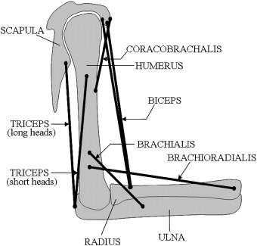
Objective:
To study the biomechanics of the human arm muscles, derive actuator parameters based on human muscle capability, and analyse the biomechanical system using suitable simulation software.
The human arm is a complex biomechanical system in which muscles generate force and motion through coordinated interaction with bones and joints.
The overall objective of the internship is to study the biomechanics of the human arm, understand the mechanical capability of human muscles, derive relevant actuator parameters, and finally perform analysis and simulation using available software.
images source : Google

Slide 4
Bones and Muscles involved in Human Arm are:
Major Bones:
Humerus – Upper arm bone
Radius – Forearm bone on the thumb side
Ulna – Forearm bone on the little-finger side
Major Muscles:
Biceps brachii
Brachialis
Brachioradialis
Triceps brachii
Anconeus
Pronator teres
Ligaments:
Medial Collateral Ligament [MCL]
Lateral Collateral Ligament [LCL]
Annular Ligament
Tendons:
Distal Biceps Tendons
Triceps Tendons
Brachialis Tendon
Common Flex and Etensor Tendons
Other:
Joint Capsule & Synovial Fluid
Bursa
Articular Cartilage
Nerves
Blood Vessels

Slide 5
Types of Motion Around the Elbow Joint:
The human arm performs four major movements involving the elbow and forearm:
Flexion:
Bending of the forearm towards the upper arm, decreasing the angle at the elbow joint.
Extension:
Straightening of the forearm, increasing the angle between the upper arm and forearm.
Pronation:
Rotational movement of the forearm that turns the palm downward.
Supination:
Rotational movement of the forearm that turns the palm upward.

Slide 6
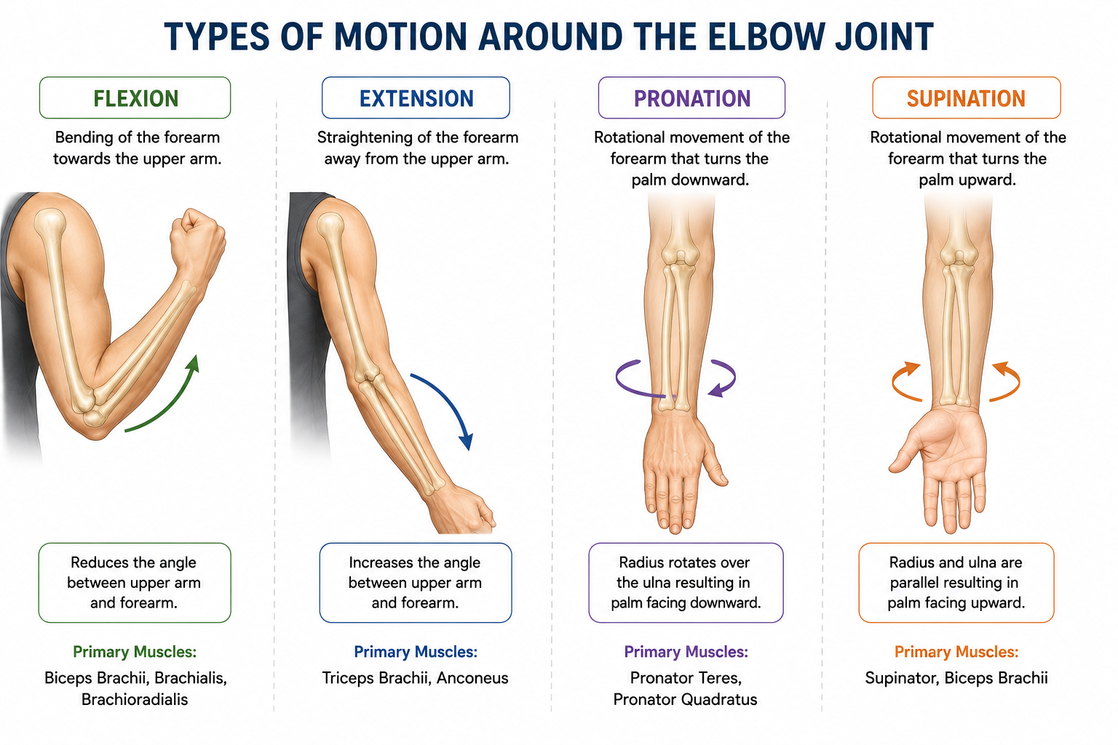
Image source: AI

Slide 7
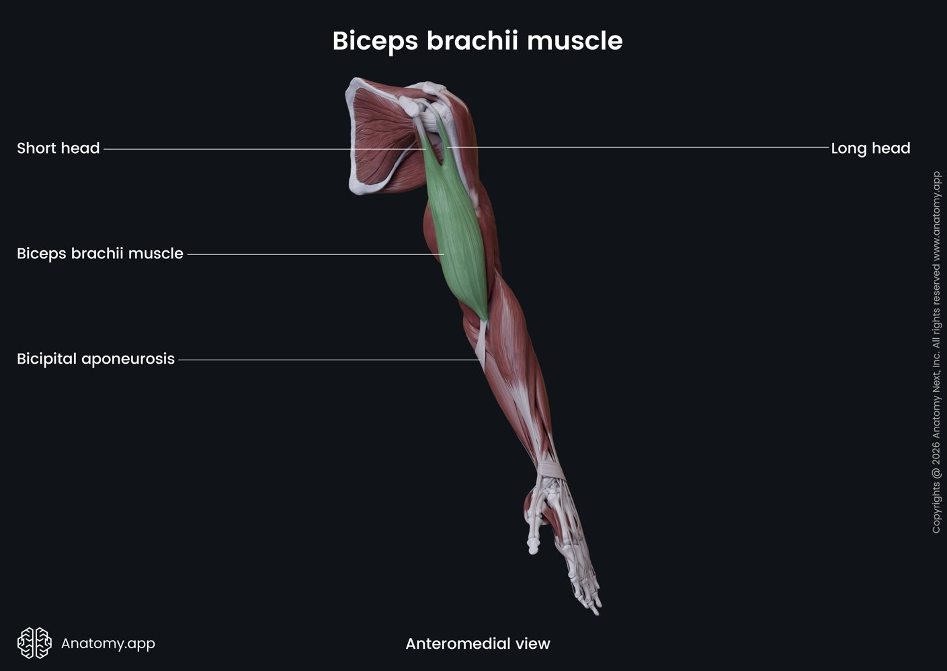
Mechanical Properties of Muscles:
1. Biceps Brachii
Mechanical Property | Parameter / Value Range
Optimal Fiber Length (L0) | 11.0 to 13.0 cm
Total Muscle-Tendon Length | 35 to 42 cm
Resting Muscle Diameter | 4.0 to 6.0 cm
Contracted Muscle Diameter | 5.0 to 7.5 cm
Max Shortening Displacement | 4.0 to 5.5 cm
Physiological Cross-Sectional Area (PCSA) | 8.0 to 12.0 cm^2
Joint Arc of Motion (Elbow) | 0⁰ to 145⁰-160⁰

Slide 8
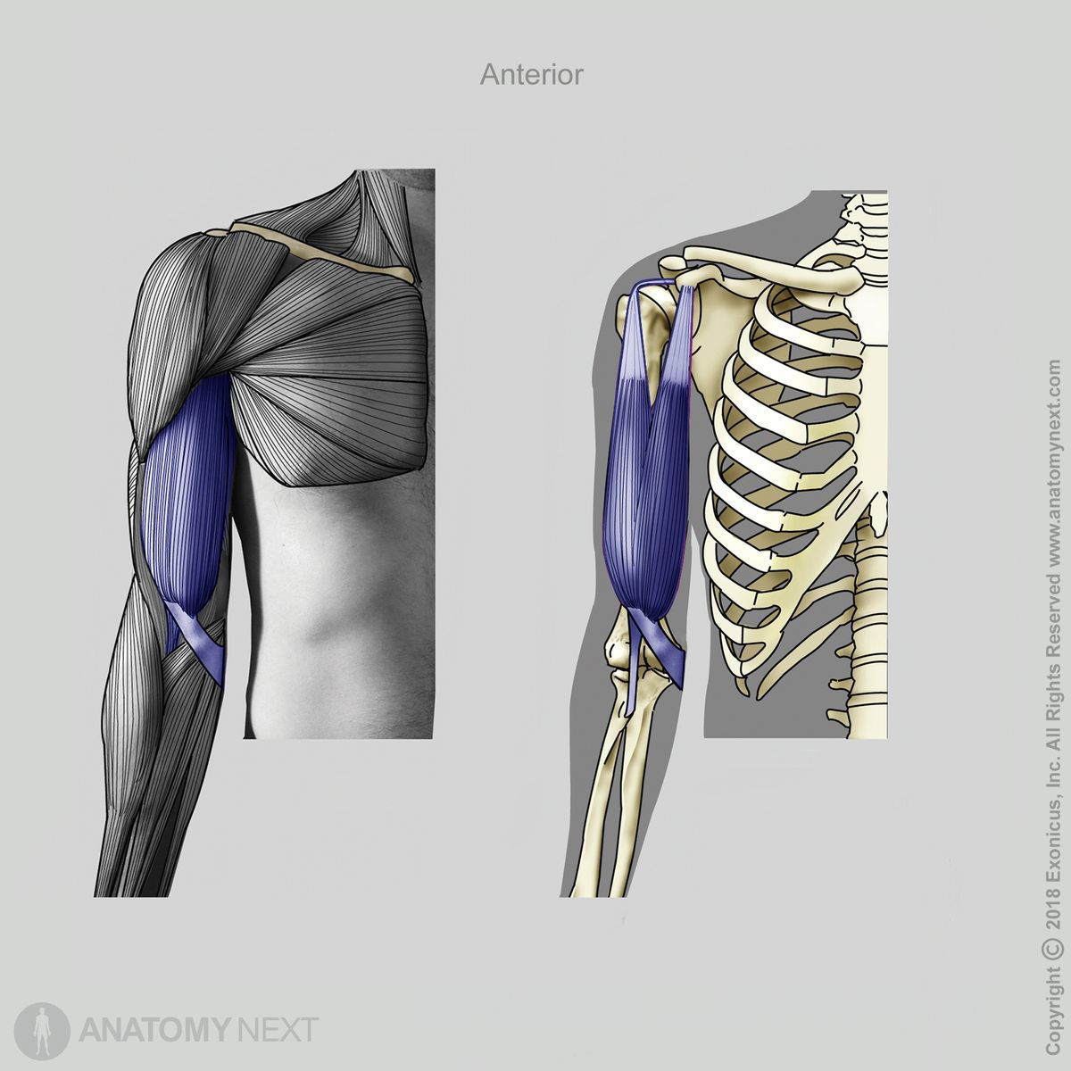
Electromechanical Delay | 30 to 50 ms
Twitch Contraction Time | 40 to 60 ms
Max Internal Force (F0) | 600 to 1100 N
Max External Joint Torque | 30 to 60 Nm
Estimated External Payload | 15 to 30 kg
Resting Tendon CSA | 15 to 25 mm^2
Tendon Stiffness (k) | 100 to 300 N/mm
Tendon Elasticity / Hysteresis | 5% to 10% loss
Source: Data: Adapted from Holzbaur et al. (2005), An et al. (1981) and Murray, Delp & Buchanan (1995) Images: Google

Slide 9
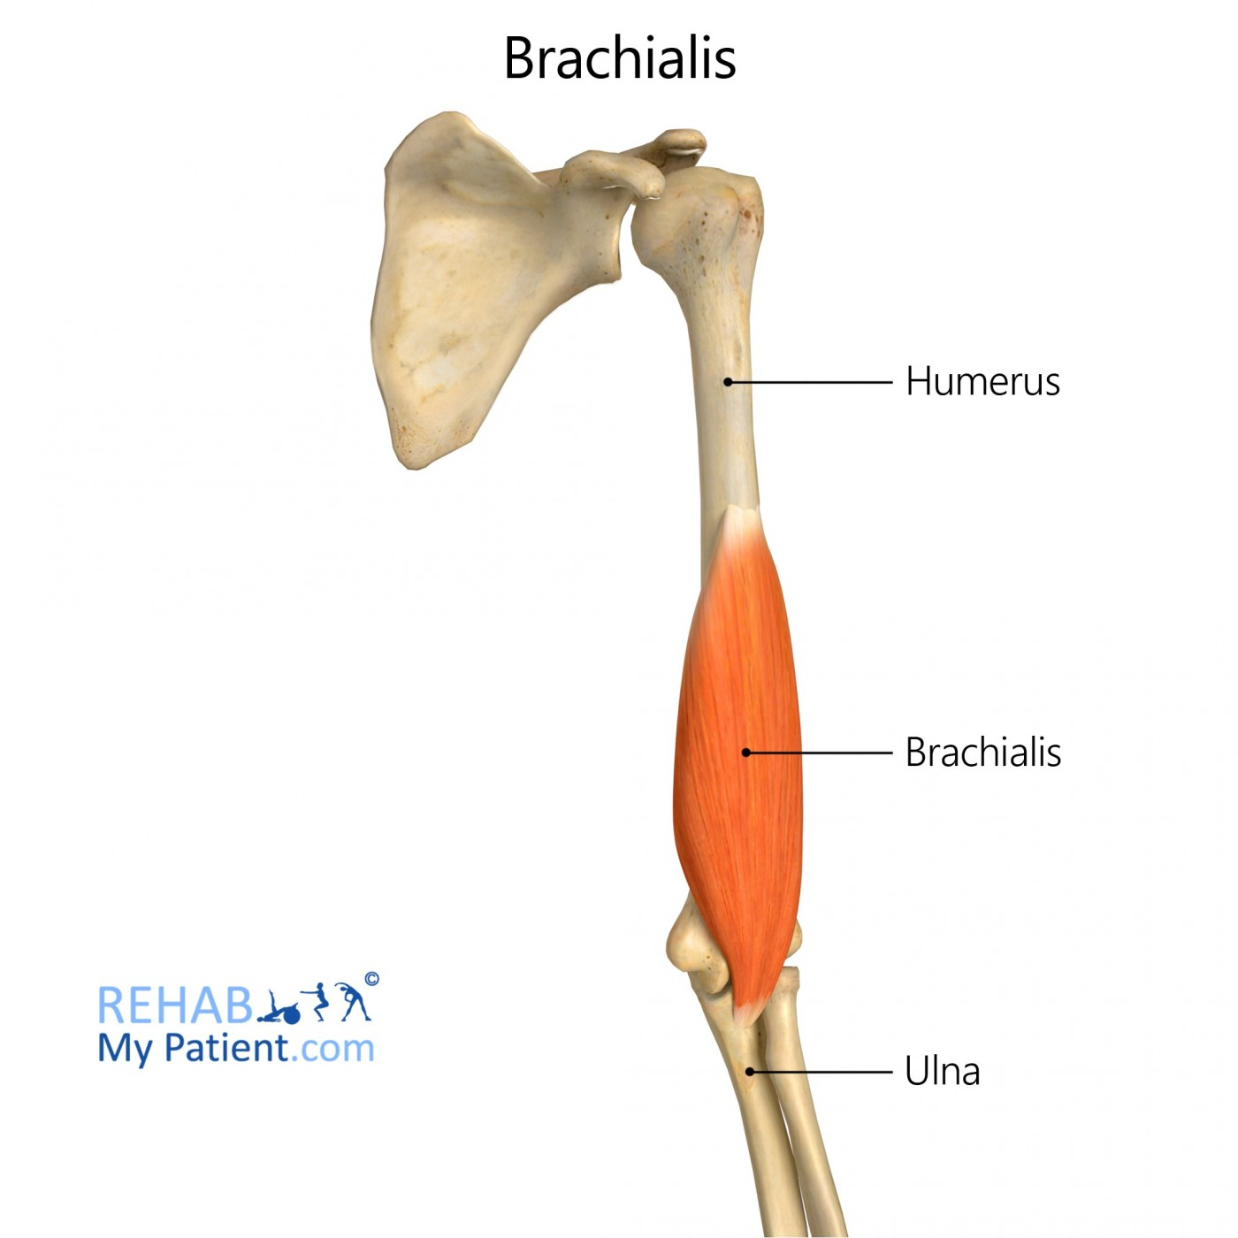
2. BRACHIALIS
Mechanical Property | Parameter / Value Range
Optimal Fiber Length (L0) | 7.0 to 9.5 cm
Total Muscle-Tendon Length | 18 to 24 cm
Resting Muscle Diameter | 3.5 to 5.0 cm
Contracted Muscle Diameter | 4.2 to 6.0 cm
Max Shortening Displacement | 2.5 to 4.0 cm
Physiological Cross-Sectional Area (PCSA) | 7.0 to 11.0 cm^2
Joint Arc of Motion (Elbow) | 0⁰ to 150⁰

Slide 10
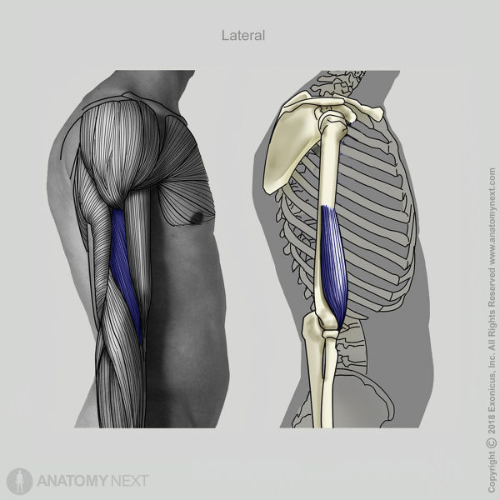
Electromechanical Delay | 30 to 45 ms
Twitch Contraction Time | 35 to 55 ms
Max Internal Force (F0) | 700 to 1000 N
Max External Joint Torque | 20 to 40 Nm
Estimated External Payload | 10 to 22 kg
Resting Tendon CSA | 10 to 20 mm^2
Tendon Stiffness (k) | 150 to 350 N/mm
Tendon Elasticity / Hysteresis | 4% to 8% loss
Source: Data: Adapted from Holzbaur et al. (2005), An et al. (1981) and Murray, Delp & Buchanan (1995) Images: Google

Slide 11
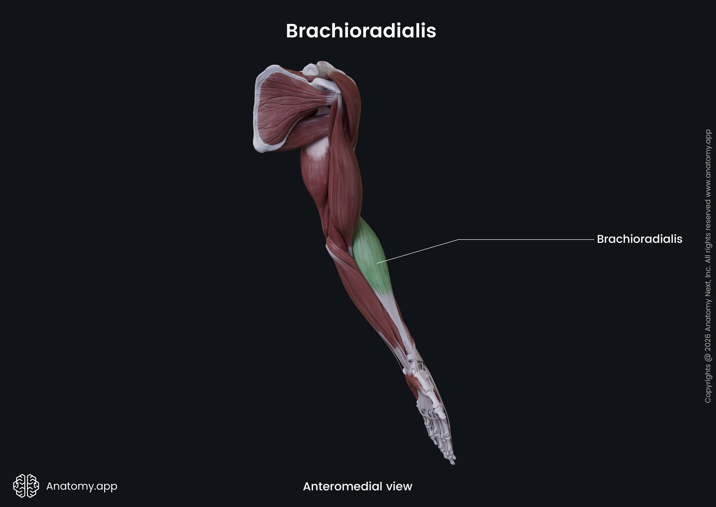
3.BRACHIORADIALIS
Mechanical Property | Parameter / Value Range
Optimal Fiber Length (L0) | 15.0 to 19.0 cm
Total Muscle-Tendon Length | 25 to 35 cm
Resting Muscle Diameter | 2.5 to 4.0 cm
Contracted Muscle Diameter | 3.0 to 4.8 cm
Max Shortening Displacement | 4.0 to 6.0 cm
Physiological Cross-Sectional Area (PCSA) | 2.0 to 4.5 cm^2
Joint Arc of Motion (Elbow) | 0⁰ to 150⁰

Slide 12
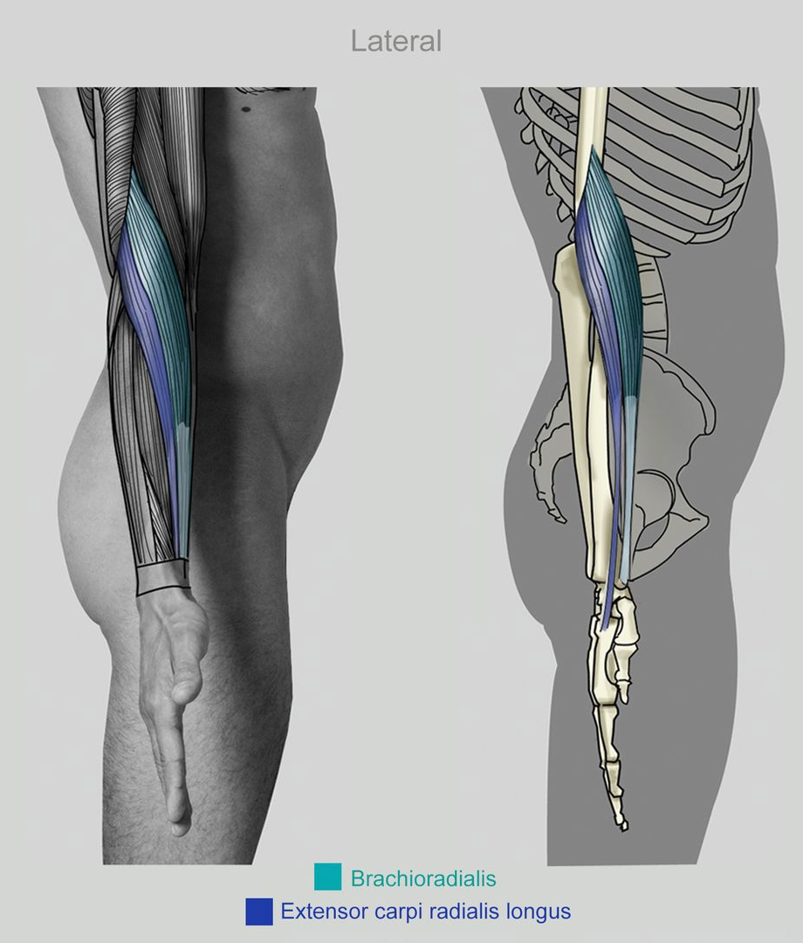
Electromechanical Delay | 30 to 45 ms
Twitch Contraction Time | 35 to 55 ms
Max Internal Force (F0) | 150 to 300 N
Max External Joint Torque | 5 to 15 Nm
Estimated External Payload | 3 to 10 kg
Resting Tendon CSA | 5 to 12 mm^2
Tendon Stiffness (k) | 80 to 200 N/mm
Tendon Elasticity / Hysteresis | 5% to 10% loss
Source: Data: Adapted from Holzbaur et al. (2005), An et al. (1981) and Murray, Delp & Buchanan (1995) Images: Google

Slide 13
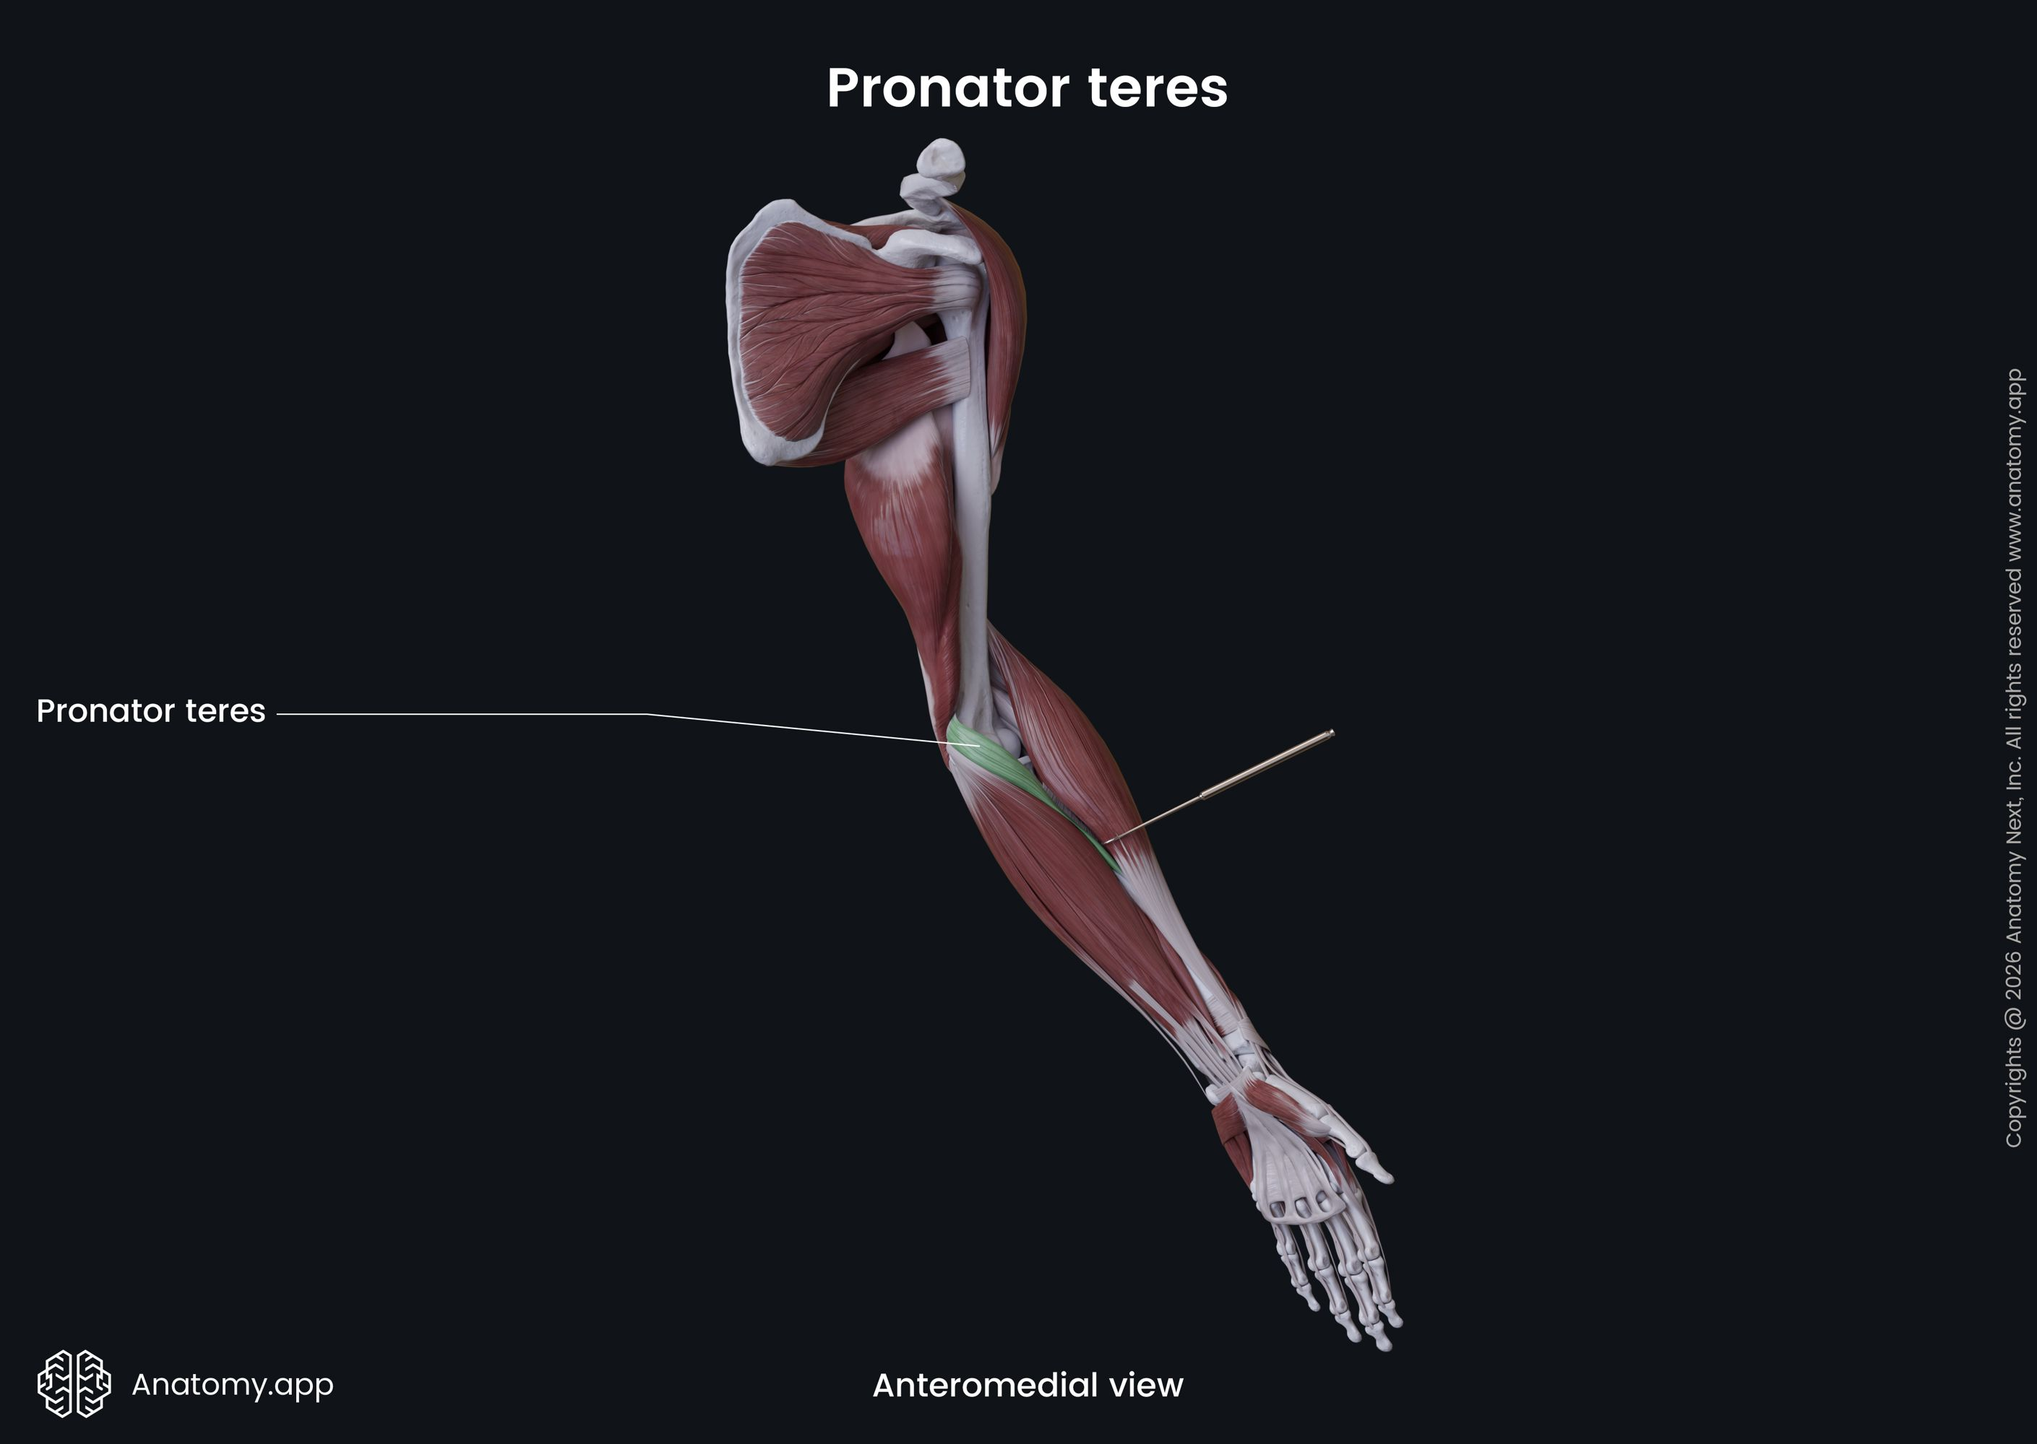
4.PRONATOR TERES
Mechanical Property | Parameter / Value Range
Optimal Fiber Length (L0) | 4.5 to 7.5 cm
Total Muscle-Tendon Length | 12 to 18 cm
Resting Muscle Diameter | 2.0 to 3.5 cm
Contracted Muscle Diameter | 2.5 to 4.2 cm
Max Shortening Displacement | 2.5 to 4.0cm
Physiological Cross-Sectional Area (PCSA) | 3.0 to 6.0 cm^2
Joint Arc of Motion | Pronation/Supination approx 150-180⁰

Slide 14
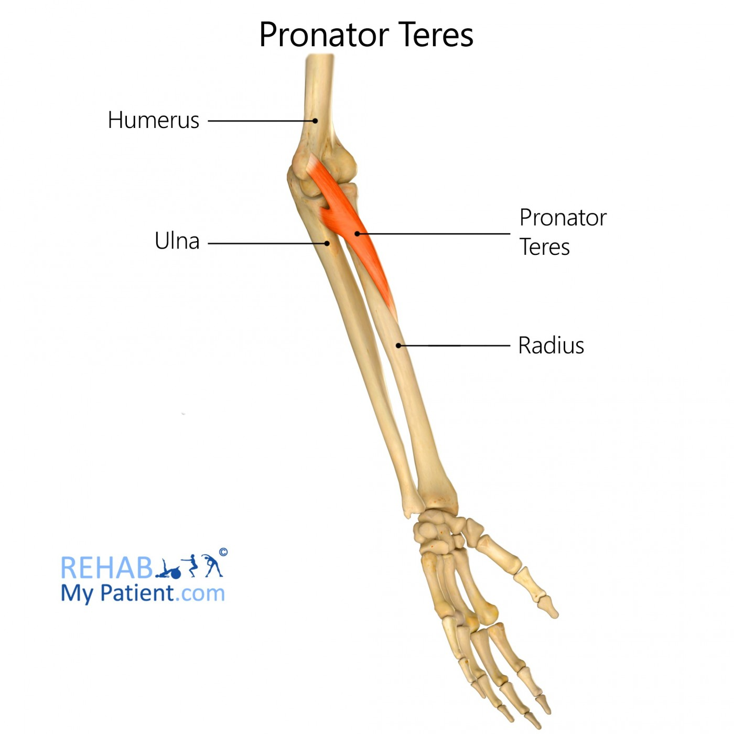
Electromechanical Delay | 30 to 45 ms
Twitch Contraction Time | 35 to 55 ms
Max Internal Force (F0) | 300 to 600 N
Max External Joint Torque | 3 to 10 Nm (Pronation)
Estimated External Payload | 2 to 8 kg
Resting Tendon CSA | 5 to 12 mm ^2
Tendon Stiffness (k) | 100 to 250 N/mm
Tendon Elasticity / Hysteresis | 5% to 10% loss
Source: Data: Adapted from Holzbaur et al. (2005), An et al. (1981) and Murray, Delp & Buchanan (1995) Images: Google

Slide 15
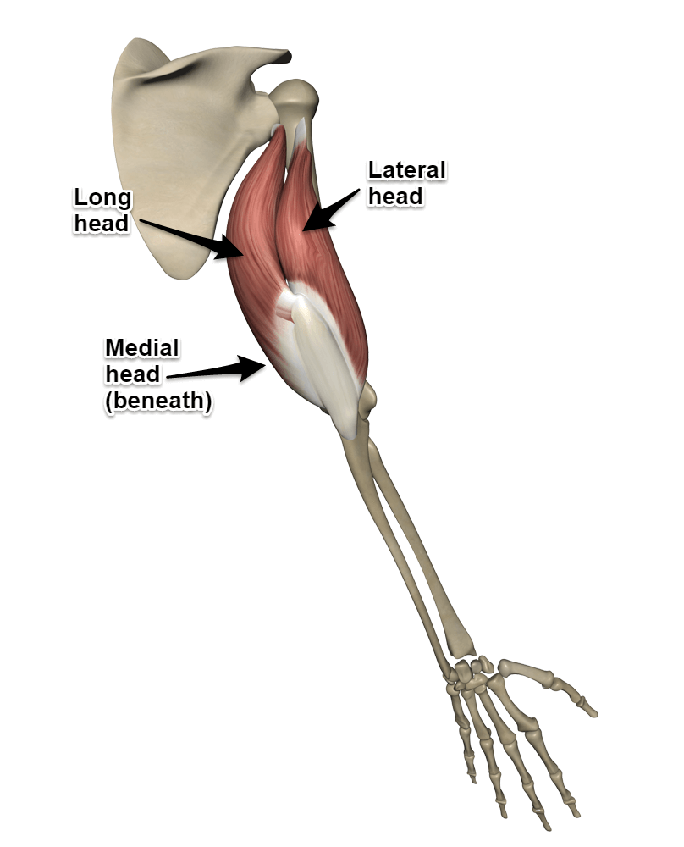
5.TRICEPS BRACHII
Mechanical Property | Parameter / Value Range
Optimal Fiber Length (Lo) | 9.0 to 14.0 cm
Total Muscle-Tendon Length | 30 to 45 cm
Resting Muscle Diameter | 4.5 to 7.0 cm
Contracted Muscle Diameter | 5.5 to 8.5 cm
Max Shortening Displacement | 4.0 to 6.5 cm
Physiological Cross-Sectional Area (PCSA) | 12.0 to 22.0 cm^2
Joint Arc of Motion (Elbow) | 0⁰ (Full Extension) to 150⁰

Slide 16
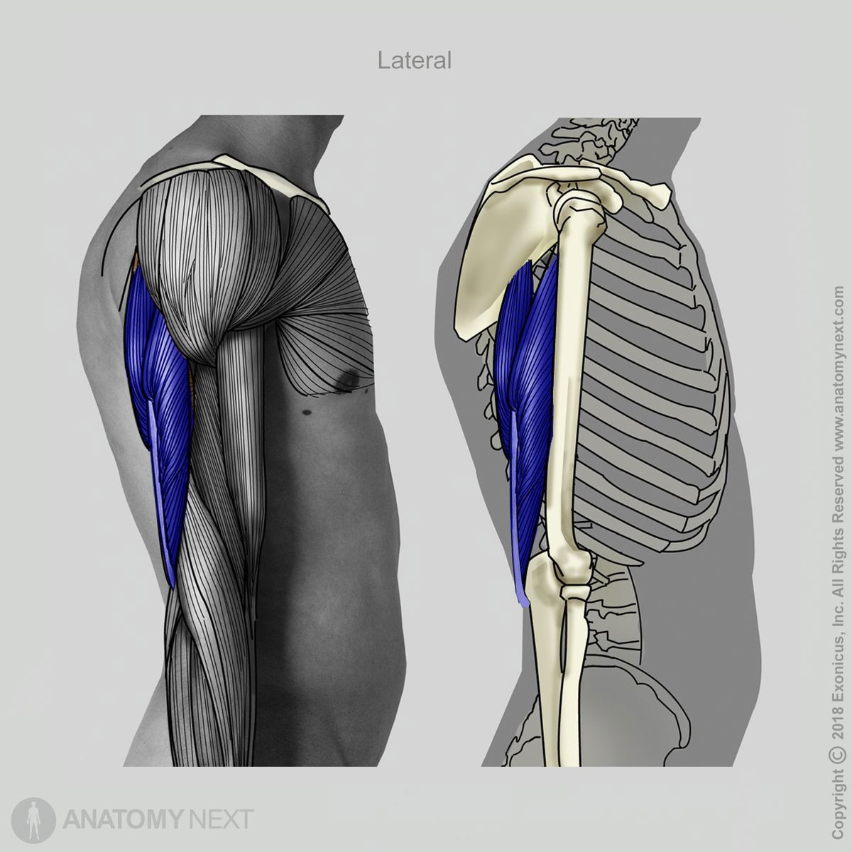
Electromechanical Delay | 30 to 50 ms
Twitch Contraction Time | 40 to 60 ms
Max Internal Force (F0) | 1000 to 2000 N
Max External Joint Torque | 40 to 90 Nm
Estimated External Payload | 20 to 45 kg
Resting Tendon CSA | 20 to 35 mm^2
Tendon Stiffness (k) | 150 to 400 N/mm
Tendon Elasticity / Hysteresis | 5% to 10% loss
Source: Data: Adapted from Holzbaur et al. (2005), An et al. (1981) and Murray, Delp & Buchanan (1995) Images: Google

Slide 17
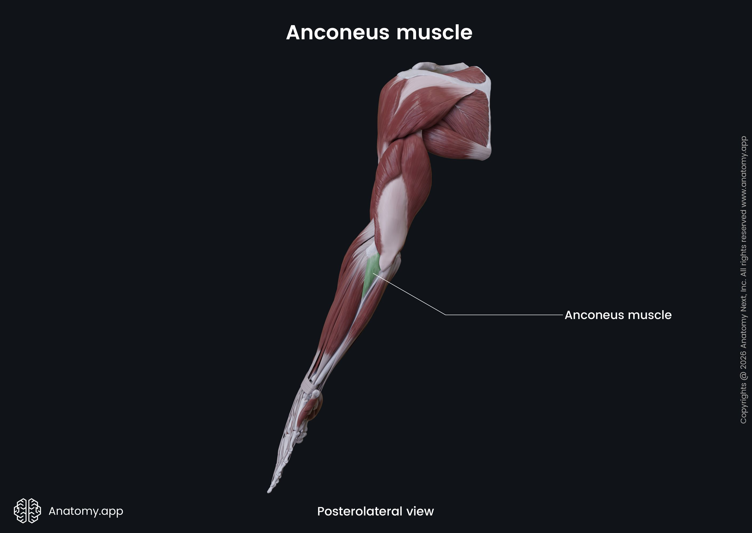
6.ANCONEUS
Mechanical Property | Parameter / Value Range
Optimal Fiber Length (L0) | 2.5 to 5.0 cm
Total Muscle-Tendon Length | 7 to 10 cm
Resting Muscle Diameter | 1.0 to 2.0 cm
Contracted Muscle Diameter | 1.2 to 2.5 cm
Max Shortening Displacement | 1.0 to 2.0 cm
Physiological Cross-Sectional Area (PCSA) | 1.0 to 2.5 cm^2
Joint Arc of Motion (Elbow) | 0⁰ to 150⁰

Slide 18
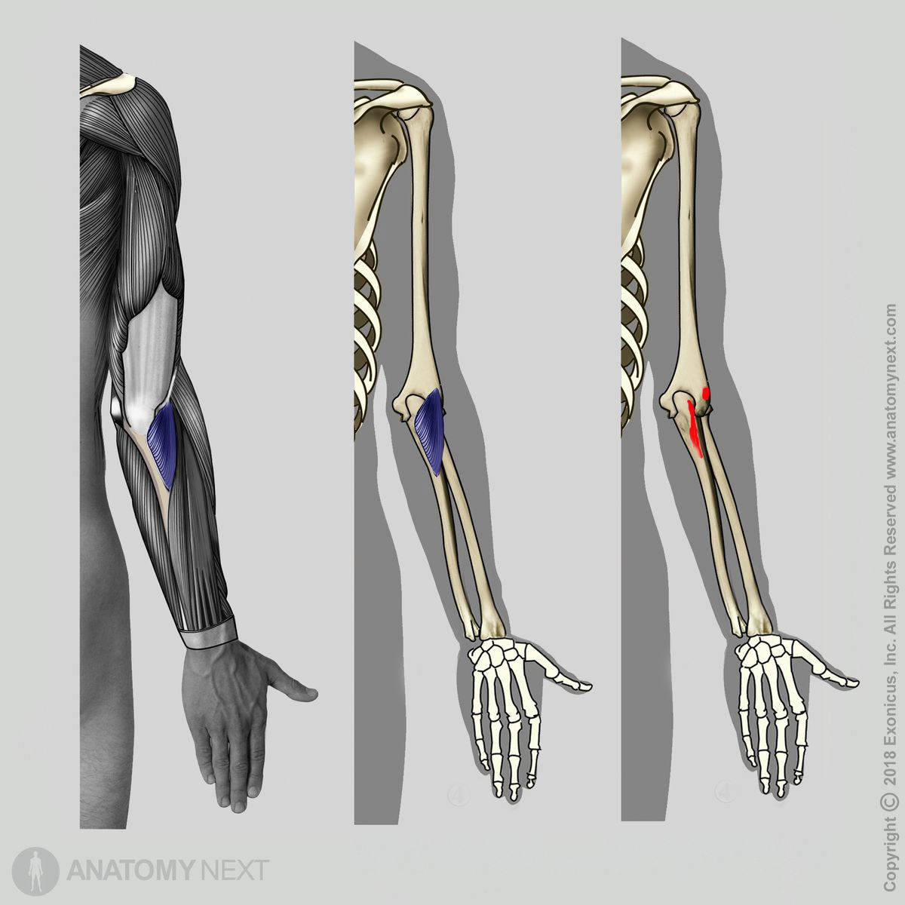
Electromechanical Delay | 30 to 45ms
Twitch Contraction Time | 35 to 55 ms
Max Internal Force (F0) | 200 to 350 N
Max External Joint Torque | 1 to 5 Nm
Estimated External Payload | 1 to 3 kg
Resting Tendon CSA | 3 to 8 mm^2
Tendon Stiffness (k) | 50 to 150 N/mm
Tendon Elasticity / Hysteresis | 5% to 10% loss
Source: Data: Adapted from Holzbaur et al. (2005), An et al. (1981) and Murray, Delp & Buchanan (1995) Images: Google

Slide 19
Mechanical Property | Biceps Brachii | BRACHIALIS | BRACHIORADIALIS | PRONATOR TERES | TRICEPS BRACHII | ANCONEUS
Optimal Fiber Length (Lo) | 11.0-13.0 cm | 7.0-9.5 cm | 15.0-19.0 cm | 4.5-7.5 cm | 9.0-14.0 cm | 2.5-5.0 cm
Resting Muscle Diameter | 4.0-6.0 cm | 3.5-5.0 cm | 2.5-4.0 cm | 2.0-3.5 cm | 4.5-7.0 cm | 1.0-2.0 cm
Contracted Muscle Diameter | 5.0-7.5 cm | 4.2-6.0 cm | 3.0-4.8 cm | 2.5-4.2 cm | 5.5-8.5 cm | 1.2-2.5 cm
Max Shortening Displacement | 4.0-5.5 cm | 2.5-4.0 cm | 4.0-6.0 cm | 2.5-4.0 cm | 4.0-6.5 cm | 1.0-2.0 cm
Max Internal Force (F0) | 600 to 1100 N | 700-1000 N | 150-300 N | 300-600 N | 1000-2000 N | 200-350 N
Electromechanical Delay | 30-50 ms | 30-45 ms | 30-45 ms | 30-45 ms | 30-50 ms | 30-45 ms

Slide 20
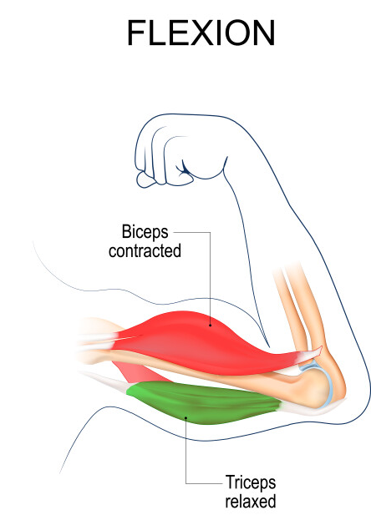
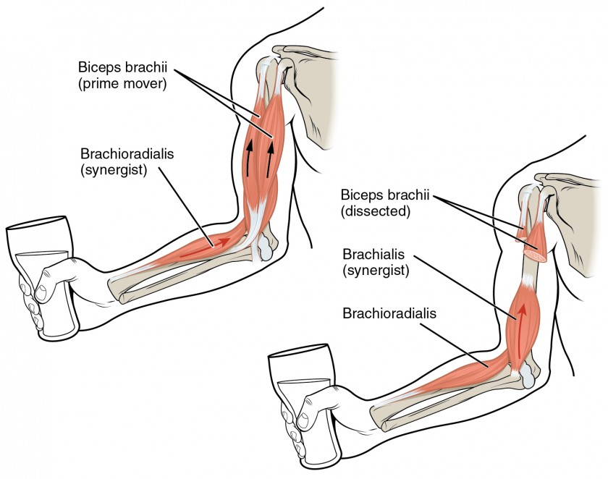
Flexion
Muscles involved in Flexion movement and its placement
Biceps brachii
Brachialis
Brachioradialis
Primary flexors: Biceps brachii and brachialis Assistive flexor: Brachioradialis
images source : Google
Photos source : Google

Slide 21
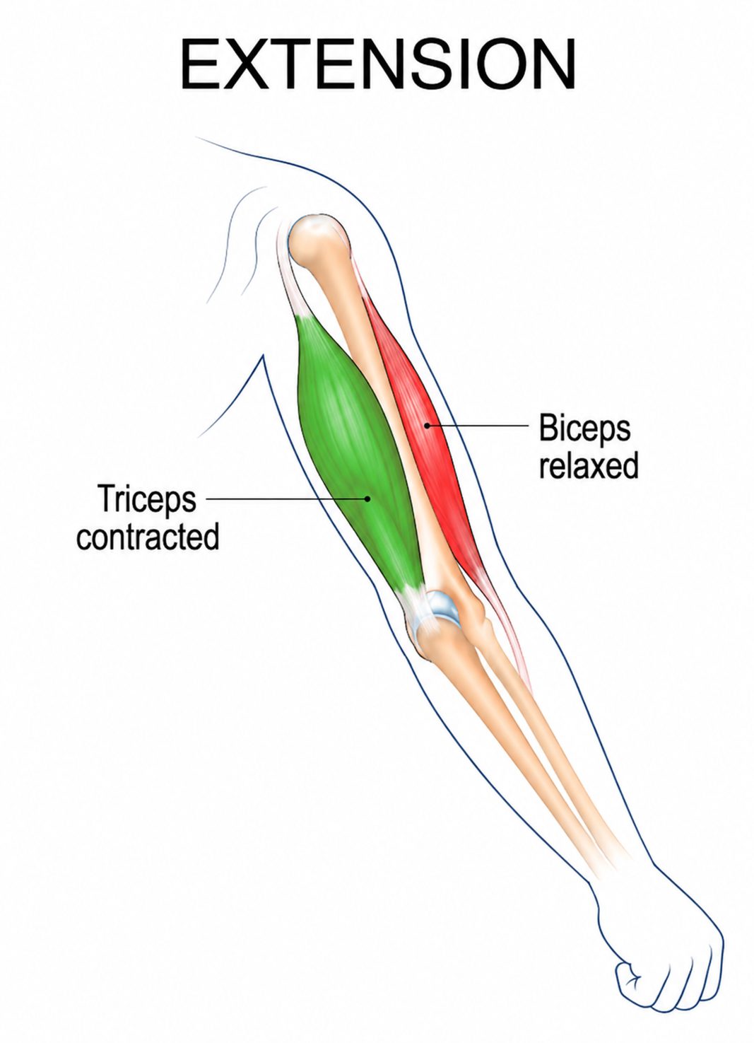
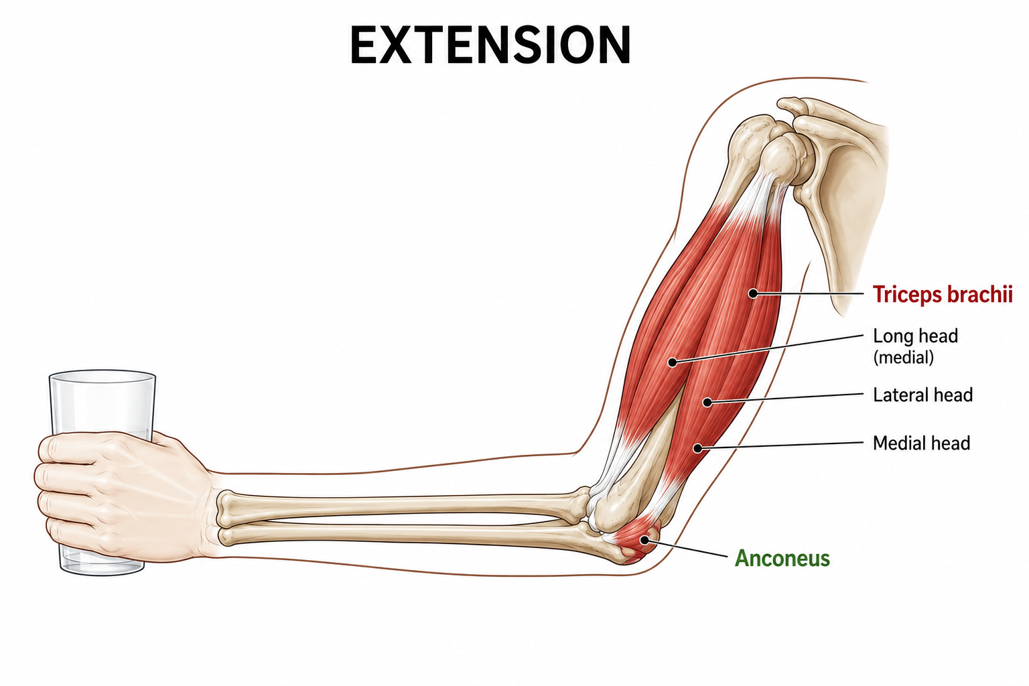
Extension
Muscles involved in Extension movement and its placement
Triceps brachii
Anconeus
Primary extensor: Triceps brachii Assistive extensor: Anconeus
images source : Google

Slide 22
Upcoming tasks which needs to be done:
Determine how the force & total joint torque is distributed amongst the participating muscles in elbow movements.
Effect of change in Elbow Joint Angle on forces.
Effect of External Load on force requirements
Identify the contribution of individual muscles during flexion and extension.
Force Requirements for Soft Actuators

Slide 23
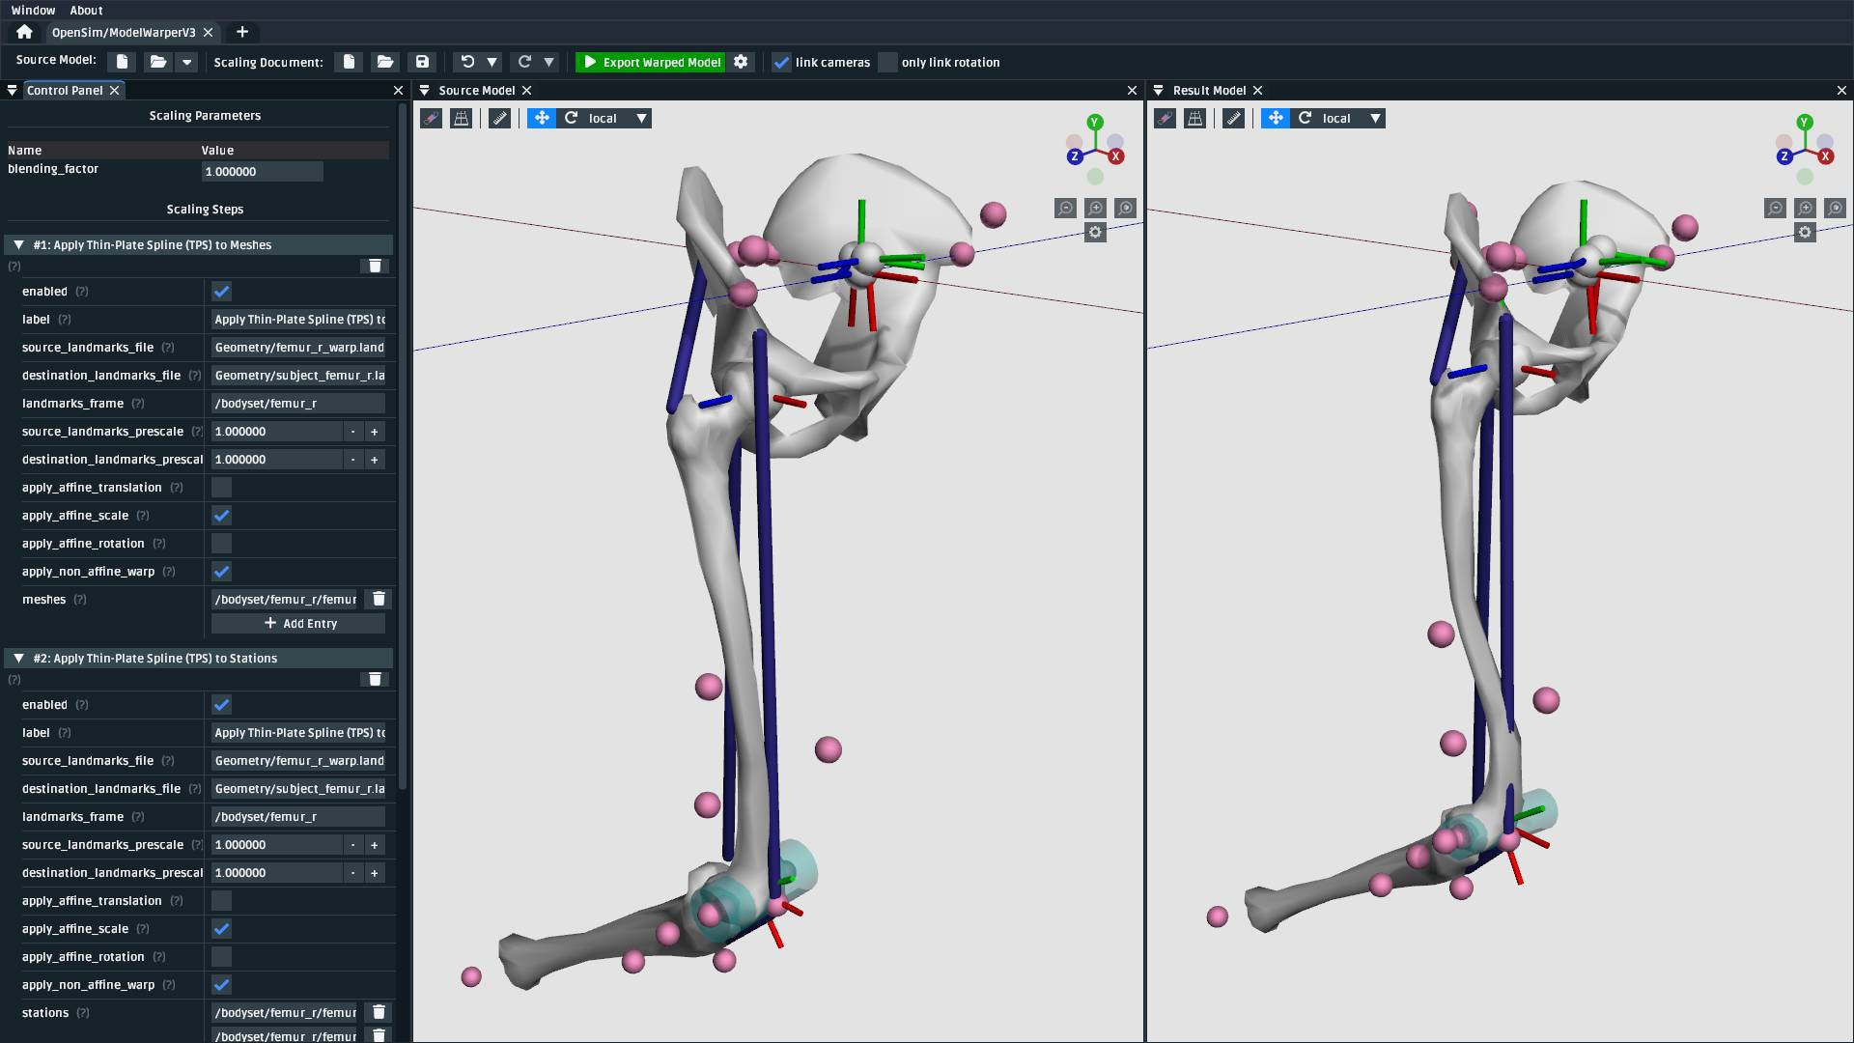
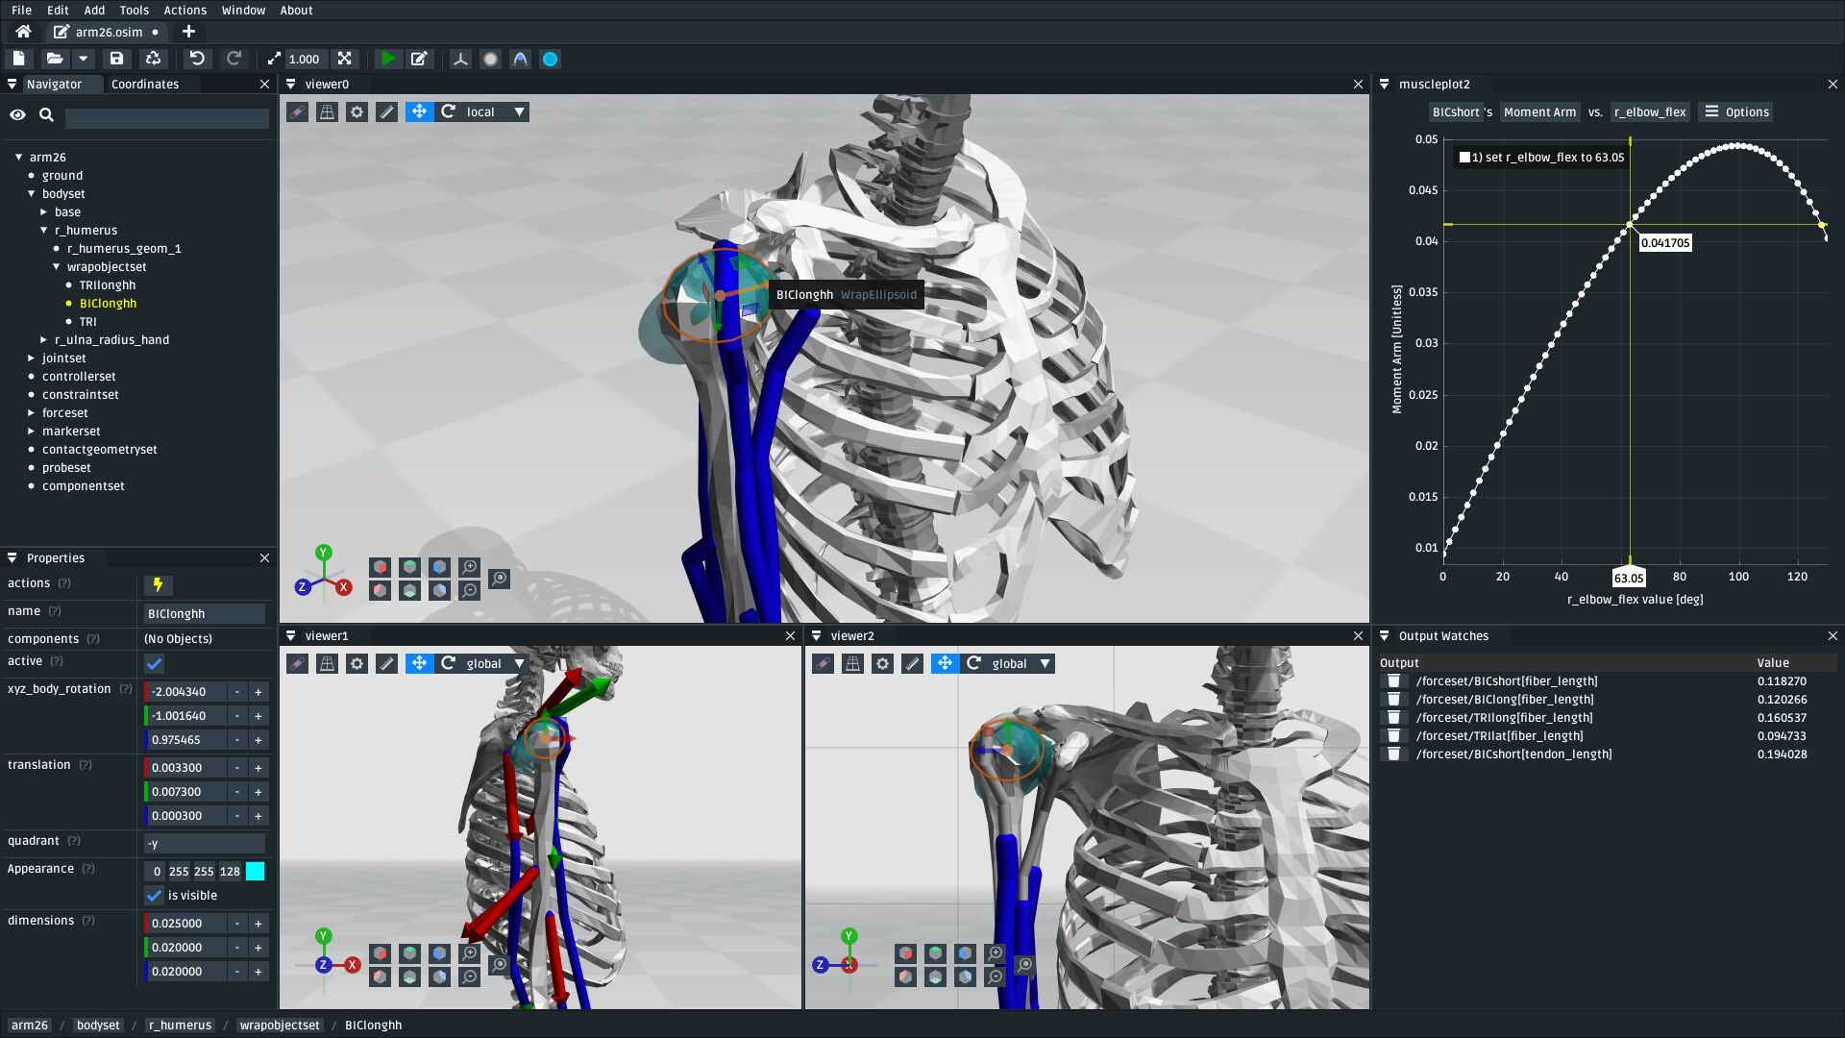
Simulation-Based Validation for Actuator Design
6. Simulation using OpenSim, Biomechanics of Bodies(BOB), MSC Adams [any suitable software].
7. Comparison and validation with published biomechanical data.
This are reference photos of simulations done in OpenSim software.
images source : Google

Slide 24
Expected Outcome of the Internship
By the end of the internship, the work will aim to:
Develop a detailed understanding of human arm biomechanics and muscle characteristics.
Analyse muscle force distribution and joint torque during different arm movements.
Study the effect of elbow joint angle and external payload on muscle force requirements.
Perform analysis and simulation using suitable biomechanical or multibody simulation software.
Compare and validate the simulation results with published biomechanical data.
Establish a reliable range of force, torque, displacement, and motion parameters.
Use these validated parameter ranges to support the design and selection of a suitable soft actuator

Slide 25
References:
Holzbaur, Murray & Delp (2005)→ PCSA, optimal fiber length, tendon slack length, peak force, upper-extremity model.
An et al. (1981)→ Original elbow muscle biomechanical analysis, fiber length, PCSA, volume and moment arms.
Murray, Delp & Buchanan (1995)→ Position-dependent moment arms of biceps, brachialis, brachioradialis, pronator teres and triceps.
Buchanan (1995)→ Specific tension and maximum force estimation for elbow flexors and extensors.
Abrams et al. (2005)→ Dedicated experimental architecture data for pronator teres.
Hodges et al. (2003)→ Muscle thickness, fascicle length, and muscle geometry changes during contraction; supports resting/non-actuated and activated/actuated muscle dimensions.
Abe et al. (2016)→ Ultrasound-based measurement of upper-extremity muscle thickness and its relationship with muscle size, cross-sectional area, and morphology
Maganaris & Paul (1999)→ In vivo tendon mechanical properties, including tendon cross-sectional area, force–elongation behavior, and stiffness.
Maganaris & Paul (2000)→ Tendon hysteresis and energy dissipation during loading and unloading of human tendons.
Cavanagh & Komi (1979)→ Electromechanical delay and force-development timing in human skeletal muscles.
Norman & Komi (1979)→ Electromechanical delay characteristics of biceps brachii and triceps brachii during normal movement conditions.
Al

